Slide 1


Email management process …
… because we all know how to handle email (NOT)
dr. Tomislav Rozman
Slideshow by Tomislav Rozman is licensed under a Creative Commons Attribution 4.0 International License.

Slide 2
Motivation
Managing your inbox is easy, right?
Wrong!
Your employees know how to communicate, right?
Wrong!
Your contacts are responsive, never lost emails, don’t have excuses, right?
Wrong!

Slide 3
Context and challenge
The challenge we are trying to solve with the “Email management process”:
ensuring sender / customer satisfaction
ensuring organization's reputation
ensuring proper routing of emails between employees
ensuring standardized response of employees to most common situations and types of incoming email
improving communication culture and netiquette
improving self-management
Context
Typical organization, which communicates with customers and partners (= nearly all organizations)
Can be also applied to personal email management
When the organization employs somebody it has to teach him/her the strategy of professional email management

Slide 4
What can we do about it?
It's not about technology!
It's about process...

Slide 5
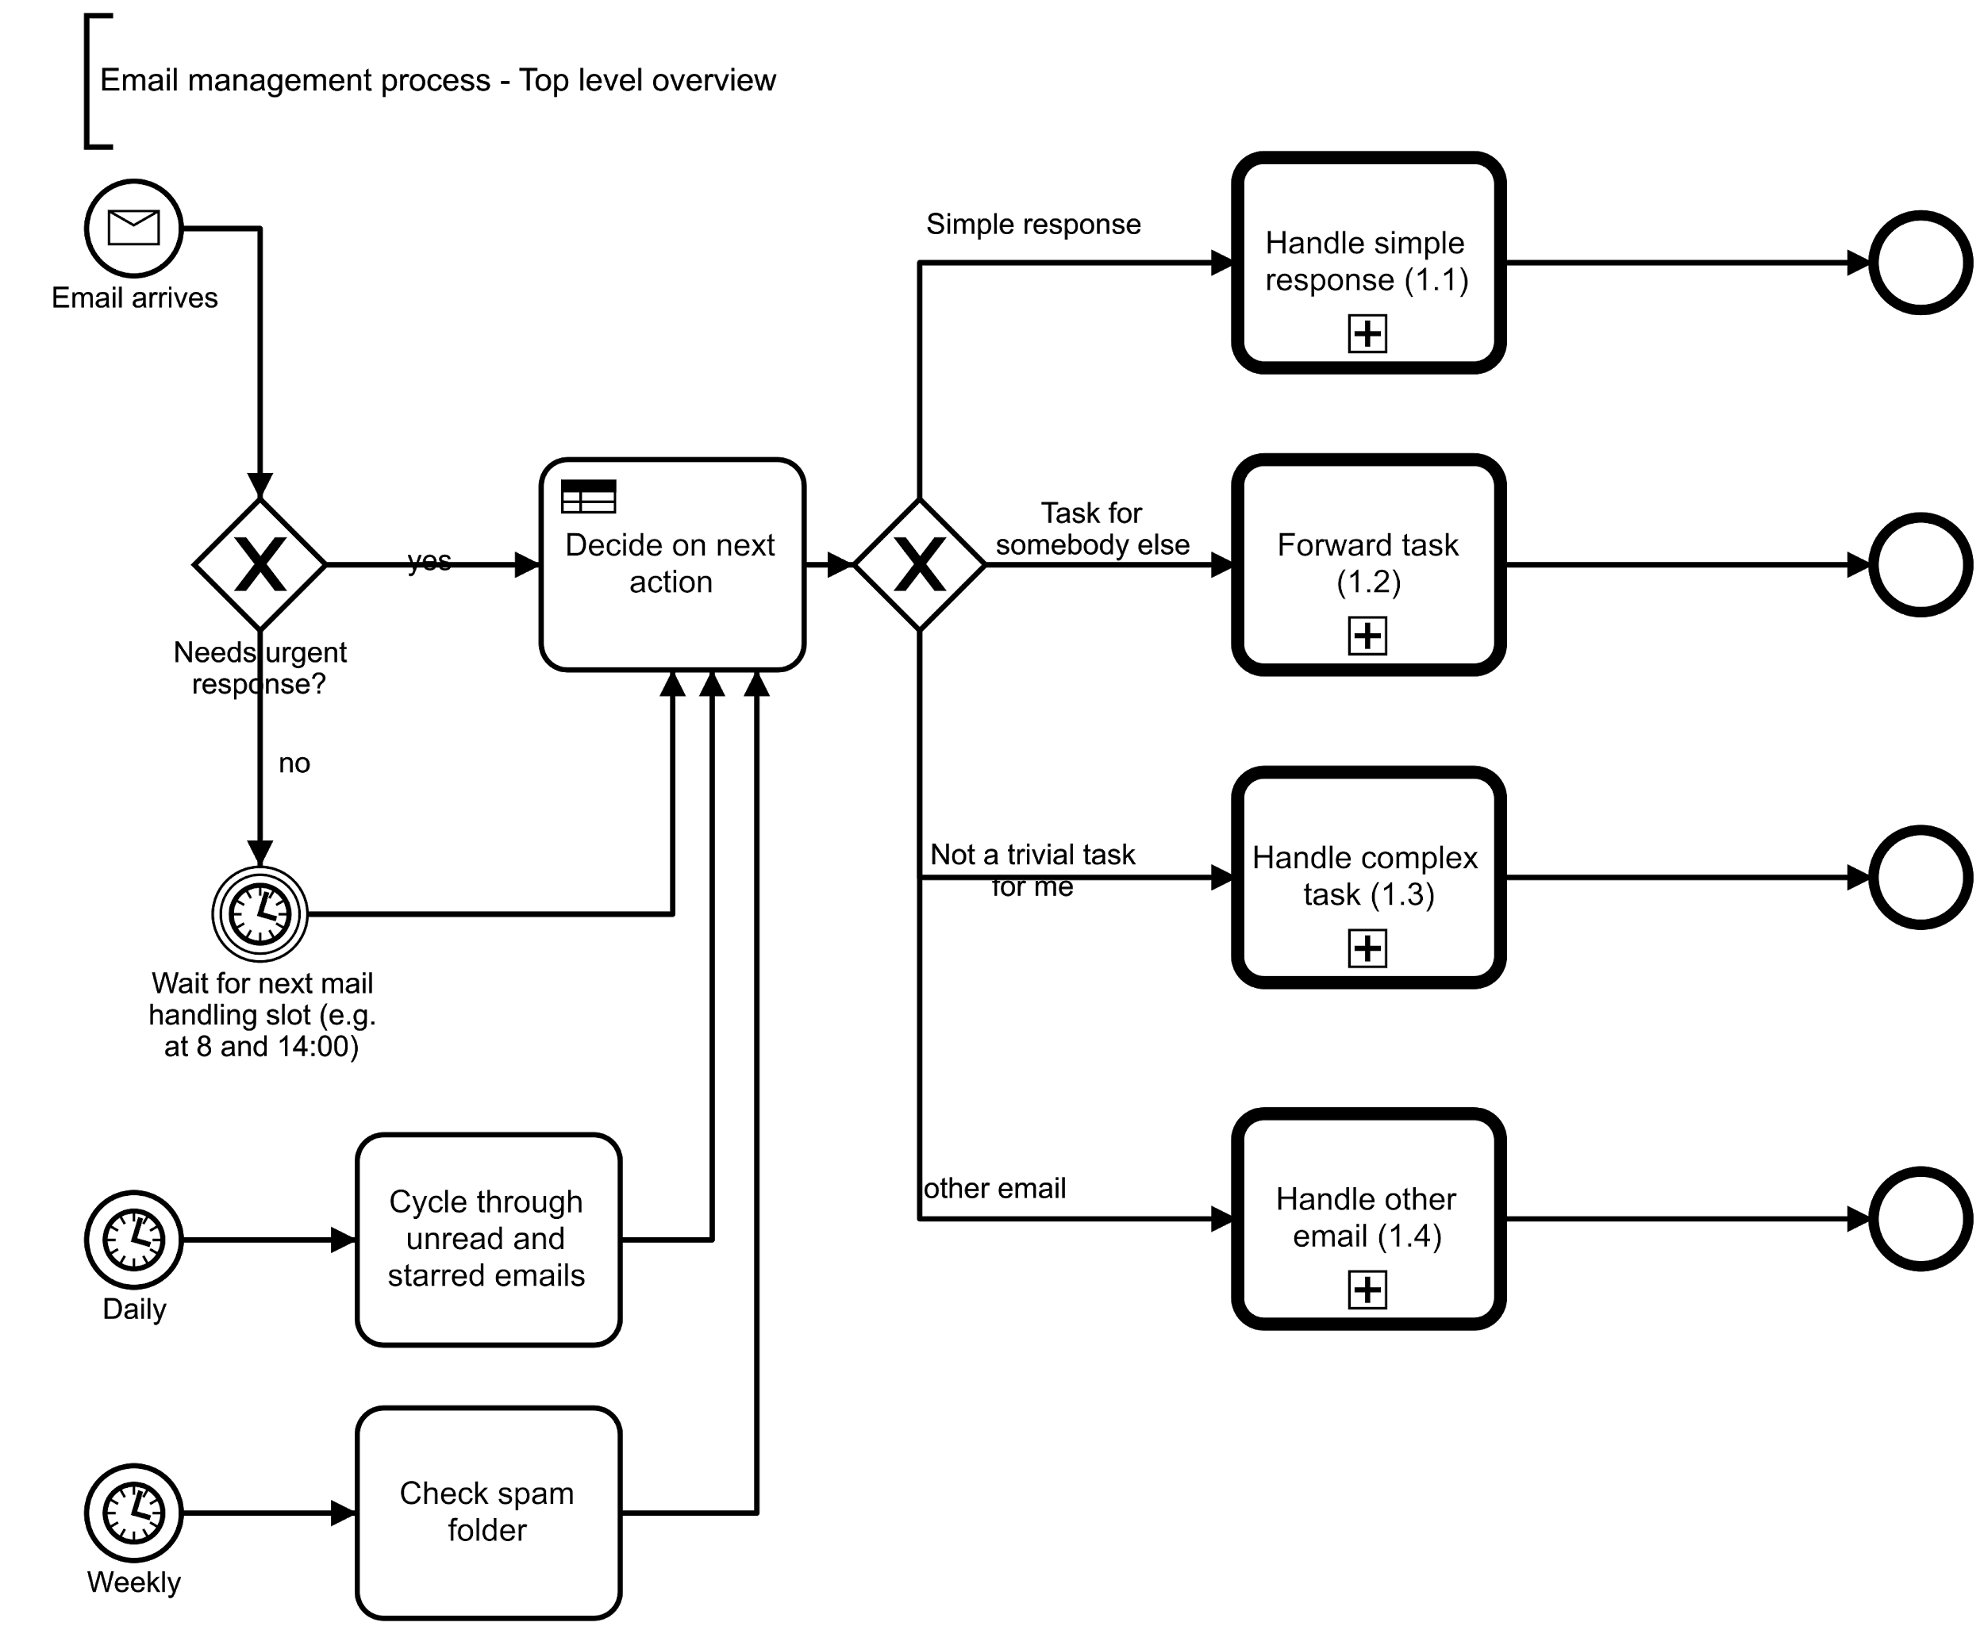
Email management process - top level overview
Click on sub-processes to see the details!
If links don’t work, see the presentation here.

Slide 6
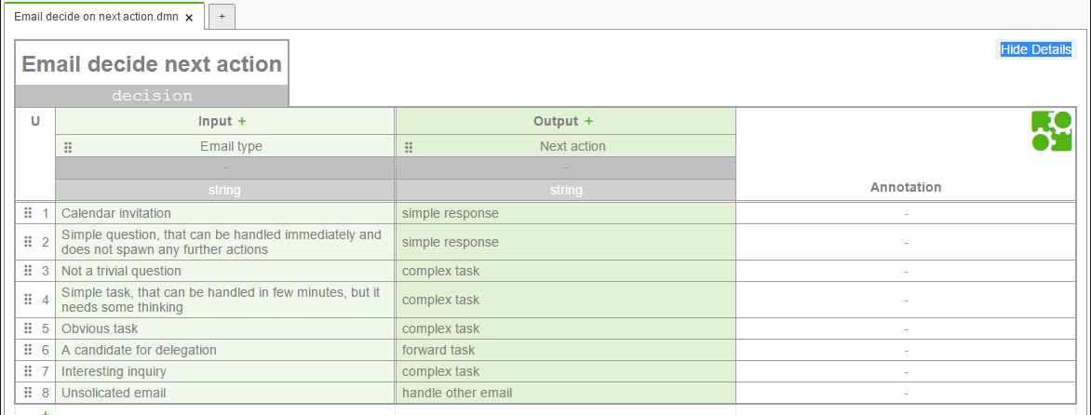
Decide on next action
Next action depends on the type of input (email)

Slide 7
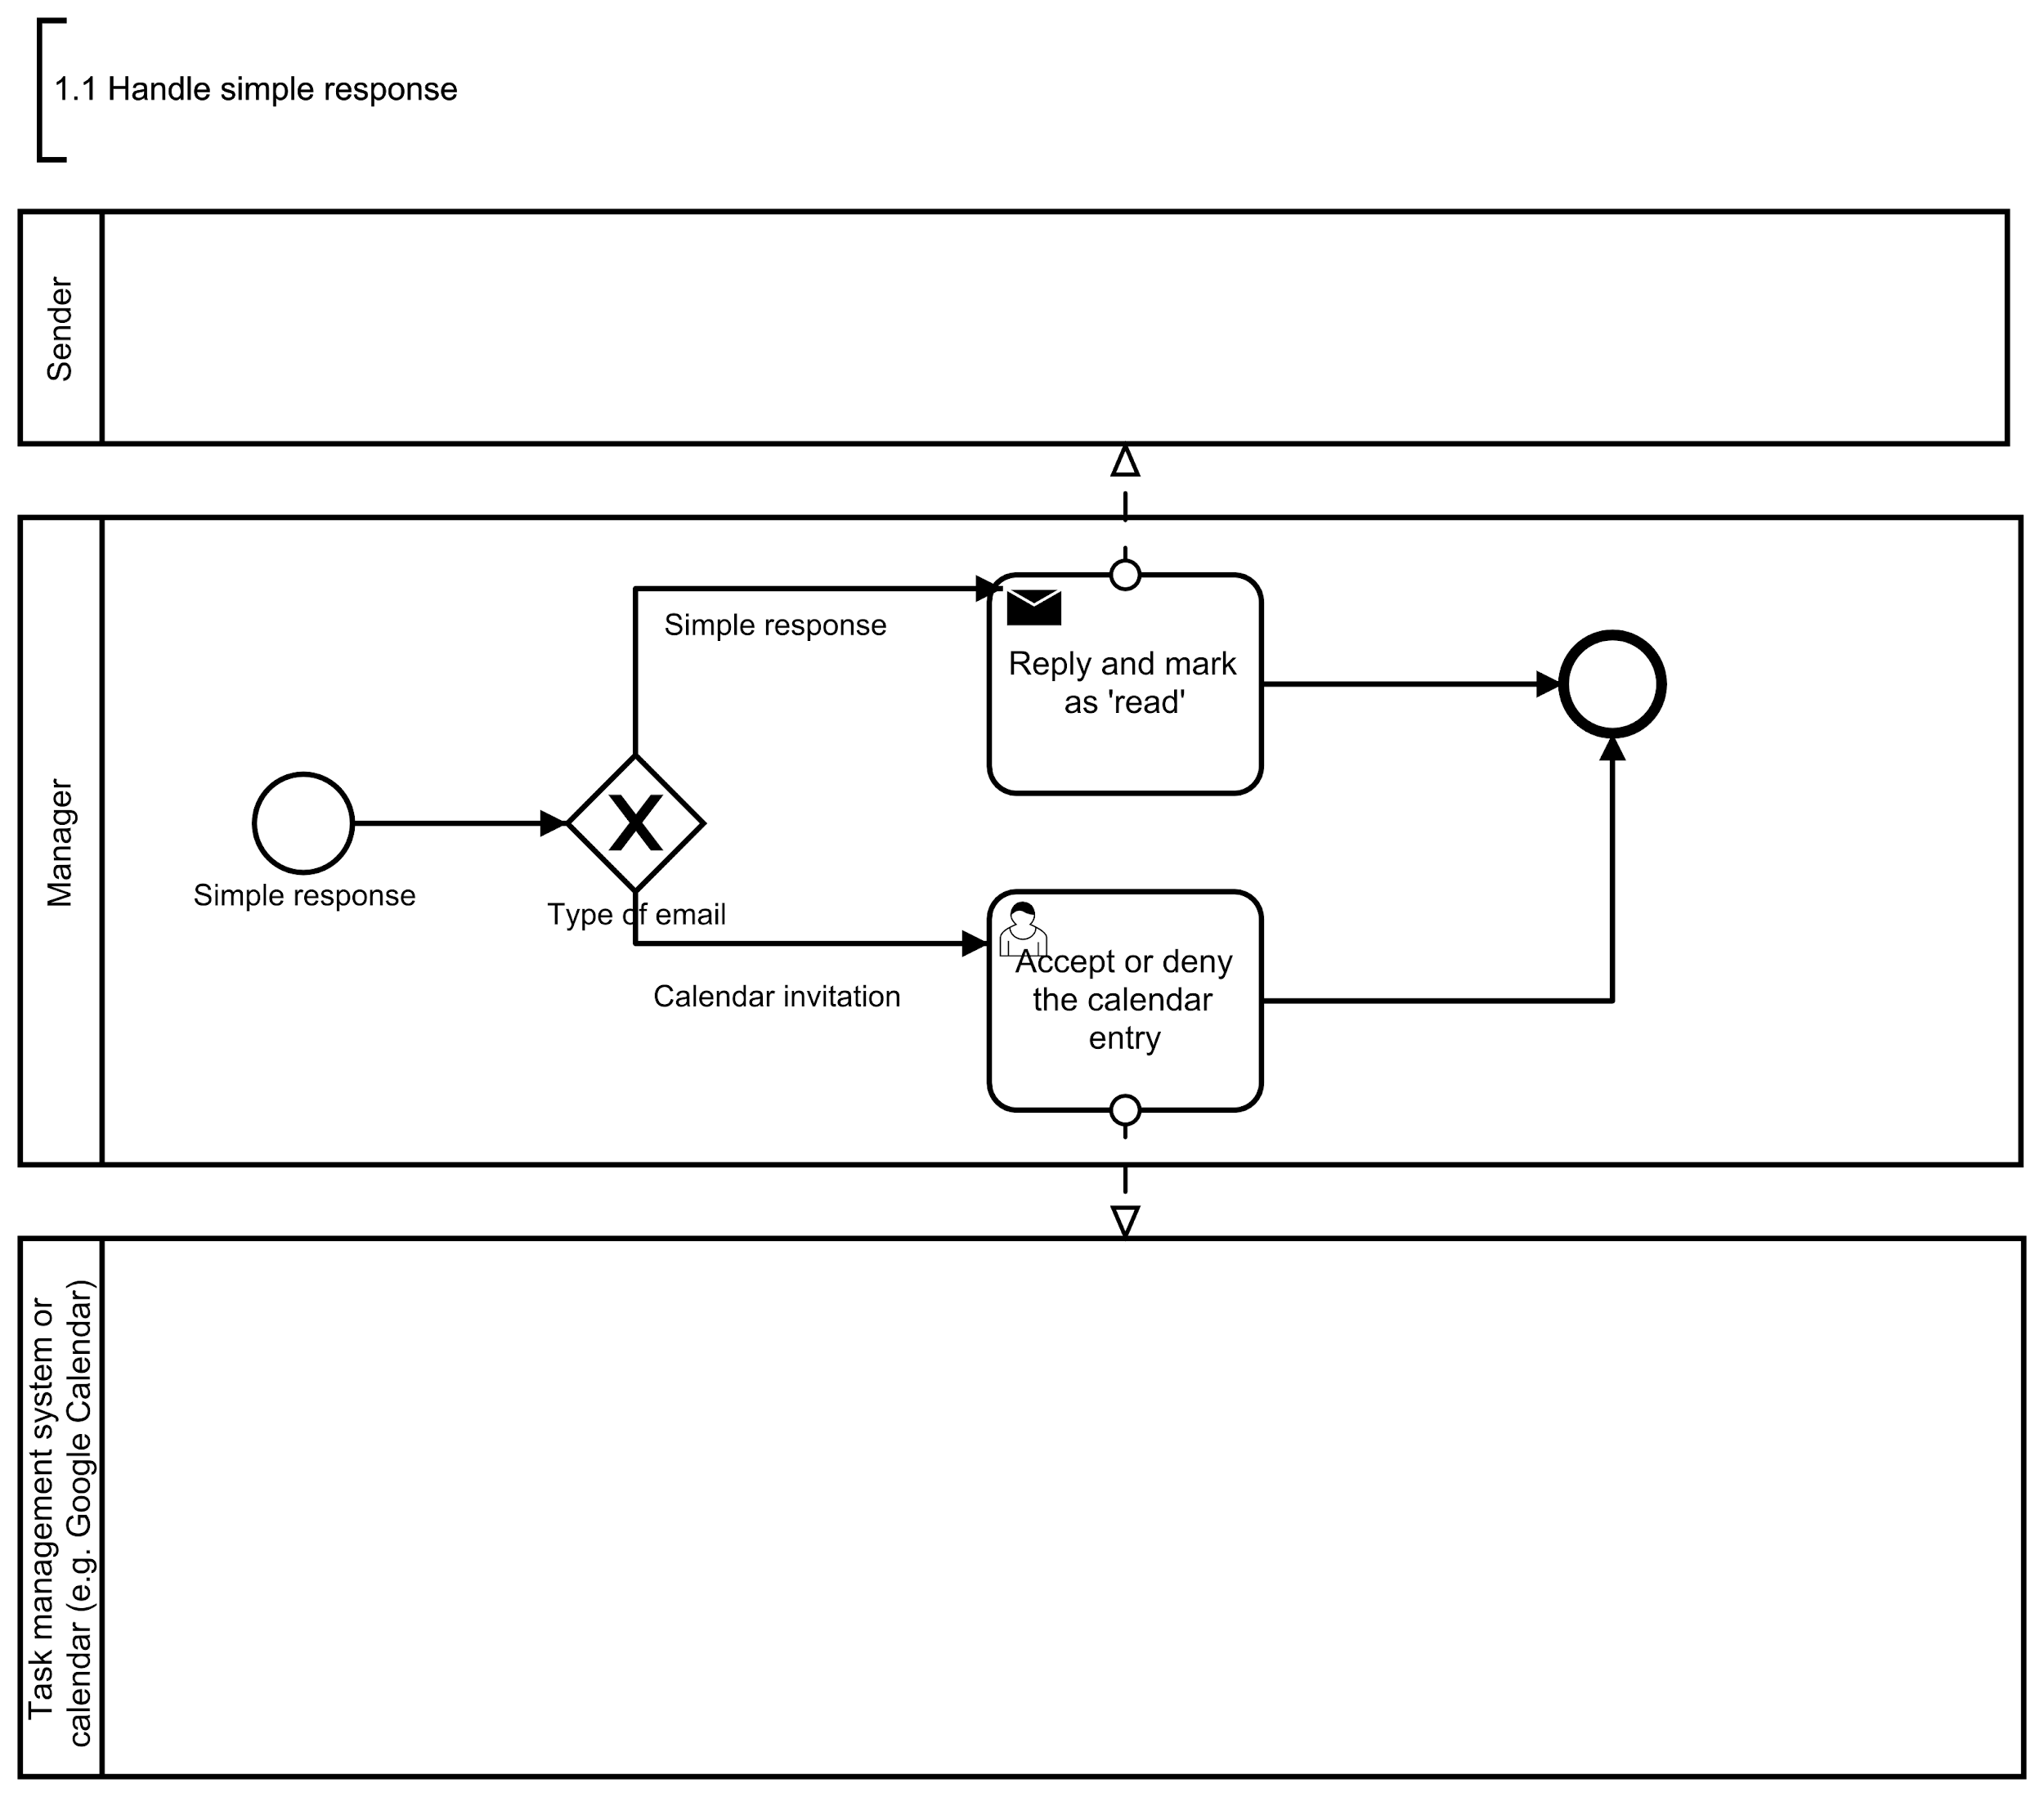
1.1 Email process -Handle simple
We want more of these! :)
One level up
What about not replying at all ? :)
What about confirm recipients ?

Slide 8
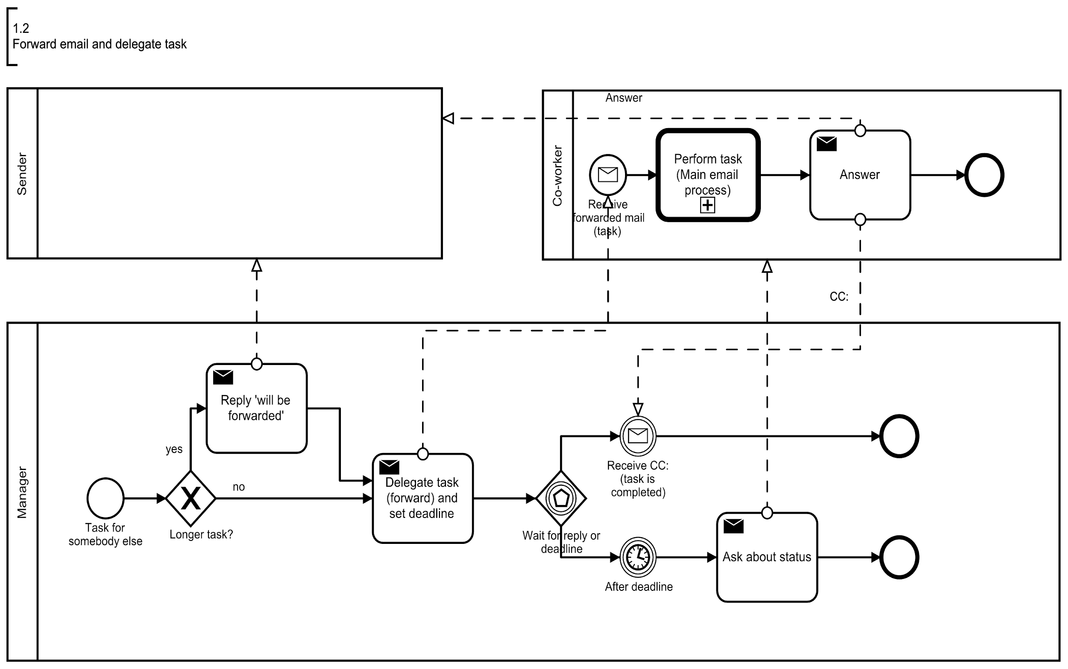
1.2 Email process - Forward
One level up
We want more of these! :)

Slide 9
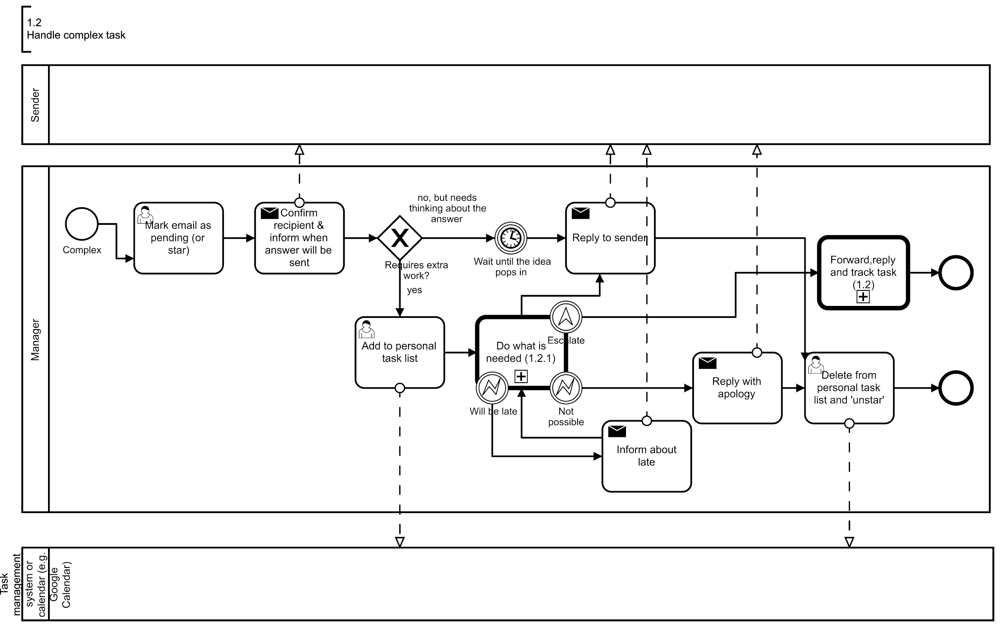
1.3 Email process -Handle complex
One level up
Critical tasks to maintain your integrity and good relations!

Slide 10
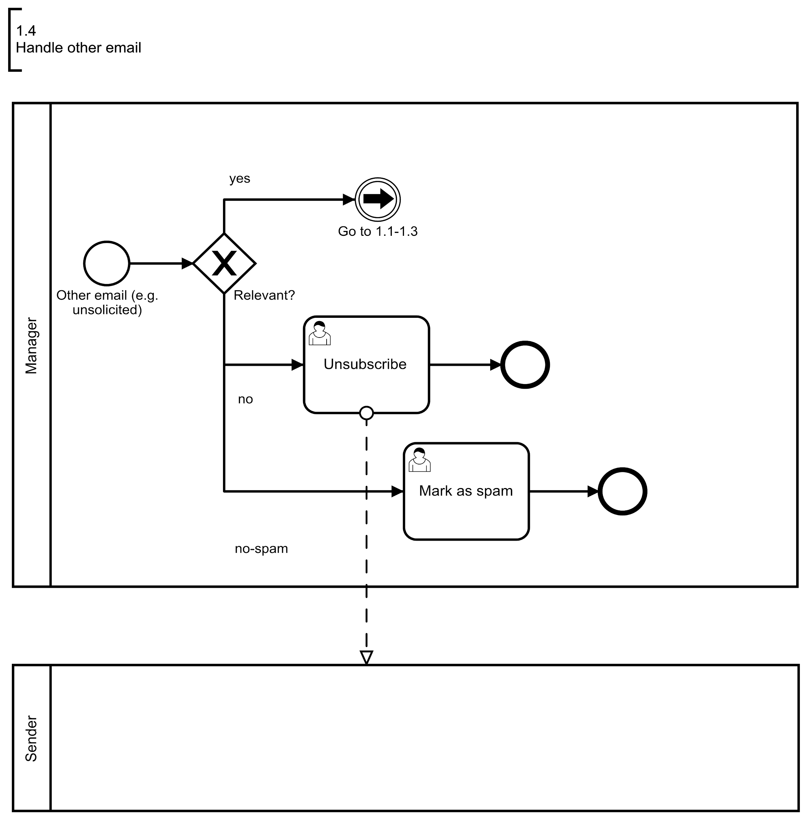
1.4 Email process -Handle other
One level up
What about ‘delete all and wait for important email to come back’?

Slide 11
After applying this process to your organization
Managing your inbox is easy, right?
A little bit better now!
Your employees know how to communicate, right?
A little bit better now!
Your contacts are responsive, never lost emails, don’t have excuses, right?
It’s improving!

Slide 12
Disclaimer
Process models / examples are partial mappings of real situations and were designed using BPMN.IO tool, a derivate of Camunda.
If you need .bpmn versions of the process models, please subscribe on the next page.
After downloading you can open process models in: BPMN.io, Camunda, Yaoquiang, Bonita BPM and possibly other tools.

Slide 13




Last but not least
Like it, share it, comment it!
And of course, don’t forget to reuse it (with contribution) in your projects.
If you want to learn how to identify, model, optimize processes, you can attend our live or on-line learning courses:
ECQA Certified Business Process Manager - Foundation and Advanced level
ECQA Certified Business Process Manager in Higher Education Institutions
i-VBPM (BPM on interactive board for VET)
Subscribe: here
Website: BICERO ltd.
E-mail: tomislav.rozman@bicero.com
LinkedIn: Tomislav Rozman

